Slide 1

DIY PROJECT
TEAM 14
TOPIC: HUMAN ACTIVITY RECOGNITION IN SPACE USING LOW COST SENSORS

Slide 2
TEAM MEMBERS
DEVADATH K (20ME10038)
SAURABH PATEL (20ME10076)
AMAN KUMAR (20CH10006)
ISHAN SINGH (20CH10026)

Slide 3
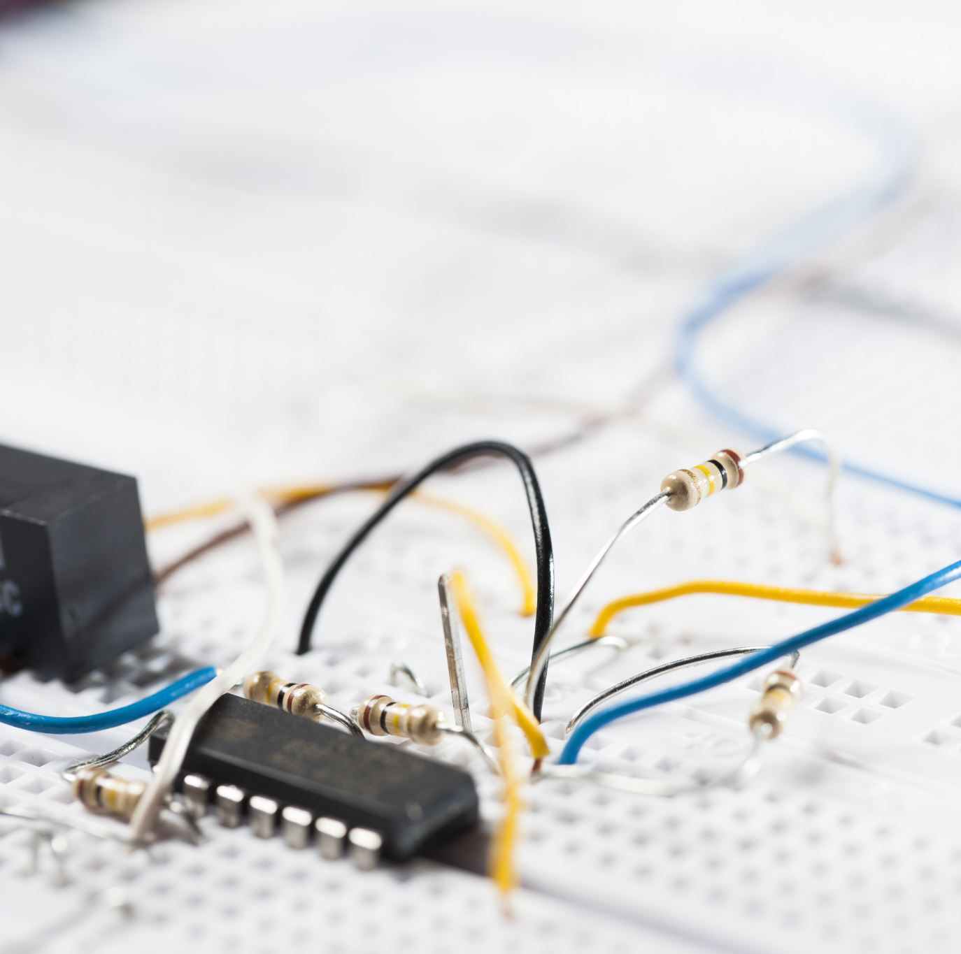
PROJECT DESCRIPTION
In our project we are going to identify multiple activities in an office room using combination of various low cost sensors(Ultrasonic sensor and decibel sensor).
In the present world lot of energy is lost due to our careless usage of electrical equipment. Using energy for only the required things for an activity can decrease loss of lots of energy.
By identifying the activities we can control the usage of electric energy and it will helps us to save energy

Slide 4
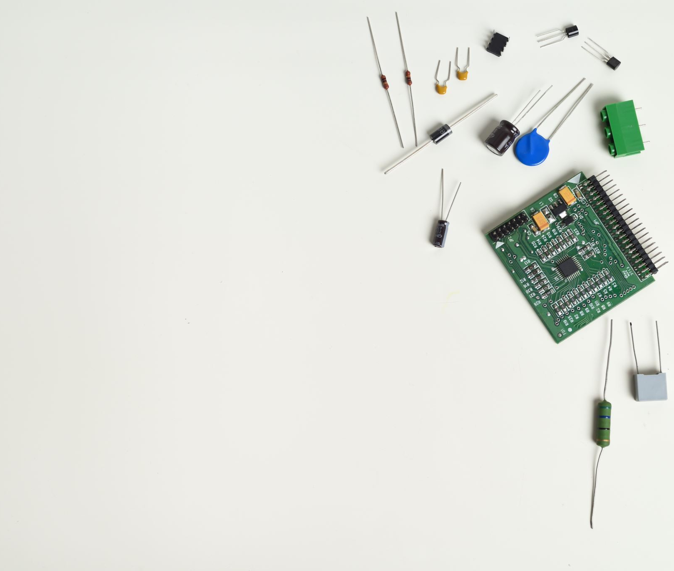
Components Required
Arduino uno R3
Ultrasonic distance sensor
Decibel sensor
LED bulb
Resistor
Breadboard
Jumper wires

Slide 5
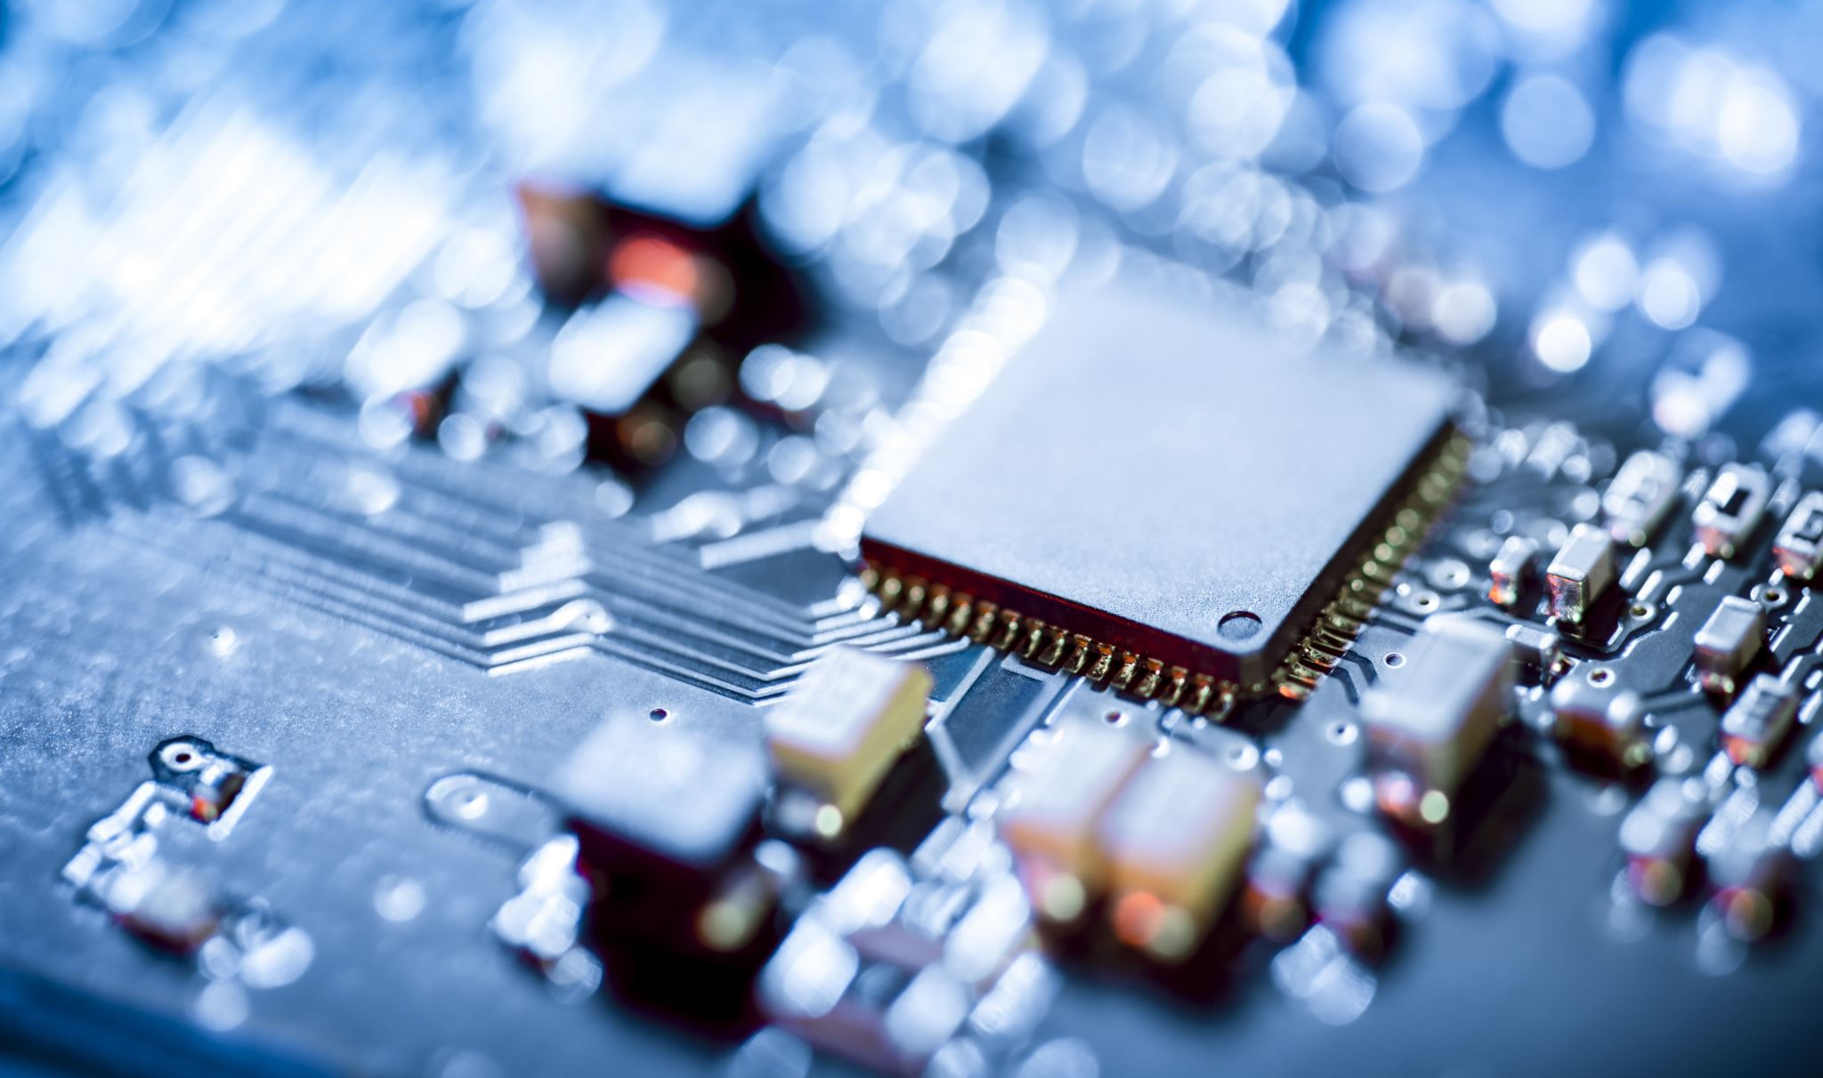
Ultrasonic sensor
Ultrasonic sensor measure distance by using ultrasonic waves. The sensor head emits an ultrasonic wave and receives the wave reflected back from the target. Ultrasonic sensor measure the distance to the target by measuring the time between the emission and reception

Slide 6
Decibel sensor
The Decibel sensor has a thin piece of material called diaphragm that vibrates when hit by sound waves. The vibration of diaphragm is converted by the sensor into an electrical signal that is sent to the LEGO brick, which knows that a sound has been heard.

Slide 7
From ultrasonic sensor we get the distance between the sensor and object. If this distance is changing we can identify whether the object is moving or not.
From the decibel sensor we will able to know the intensity of sound produced in that room.
By combining the data from both the sensors and applying various conditions we can identify the activity taking place in that room.

Slide 8
Conditions for various activities
ACTIVITY | MOVEMENT (in cm/100ms) | SOUND INTENSITY
PARTY | >20 | High
MEETING | >5 and <10 | Low
SPEECH | >10 and <20 | High
WORKING | >10 and <20 | Low
NO ACTIVITY | 0 | 0

Slide 9
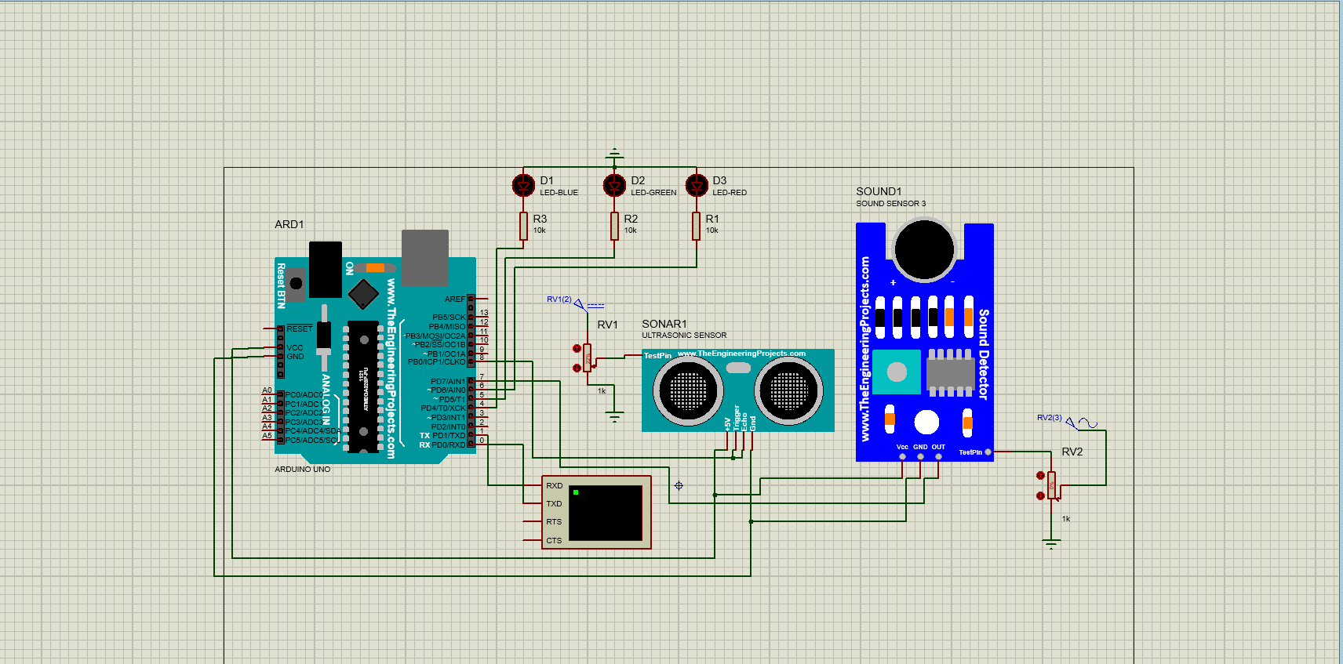
Circuit Diagram

Slide 10
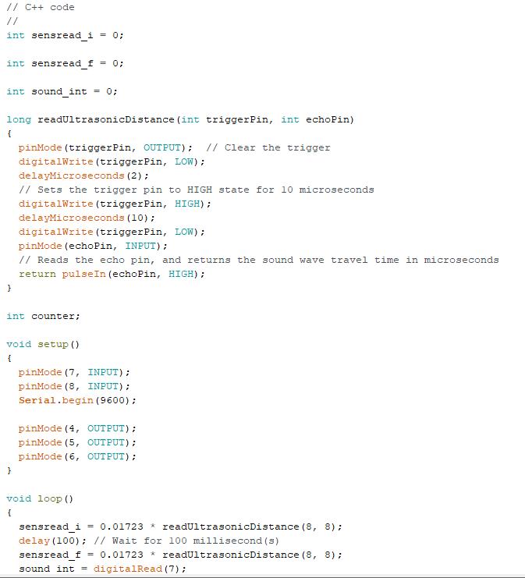
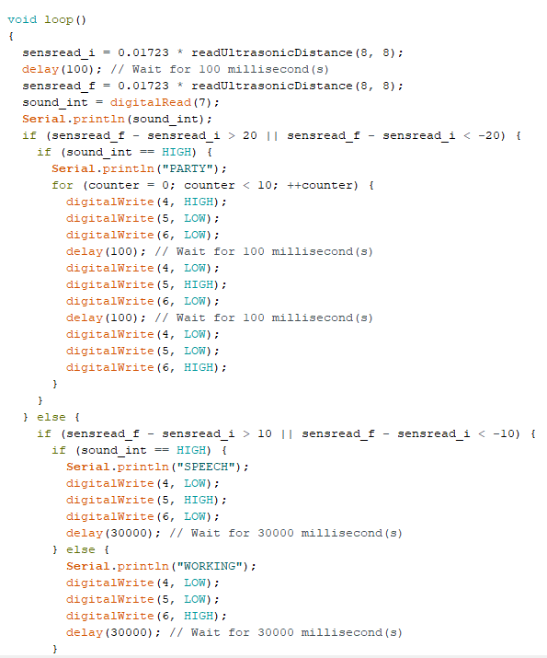
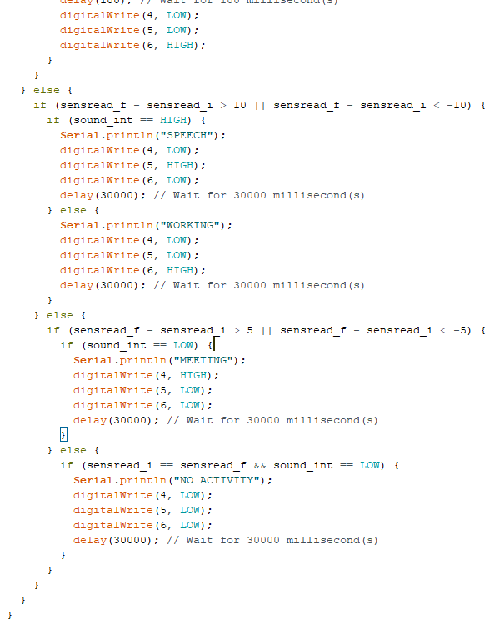
CODE

Slide 11

Individual contributions to the project
Aman Kumar: Circuit designing and simulation
Devadath K: Write code for the project and prepare ppt for each week.
Ishan Singh: Gathered information about various components and its functioning, helps in coding and prepare project report
Saurabh Patel: Assemble all components and design the circuit manually, make demonstration video and helps in coding.

Slide 12

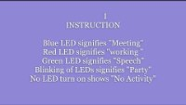
Demonstration video

Slide 13
THANK YOU

